Slide 1
Ocean Simulation
Noya Cai & Tsingtao Zhang

Slide 2
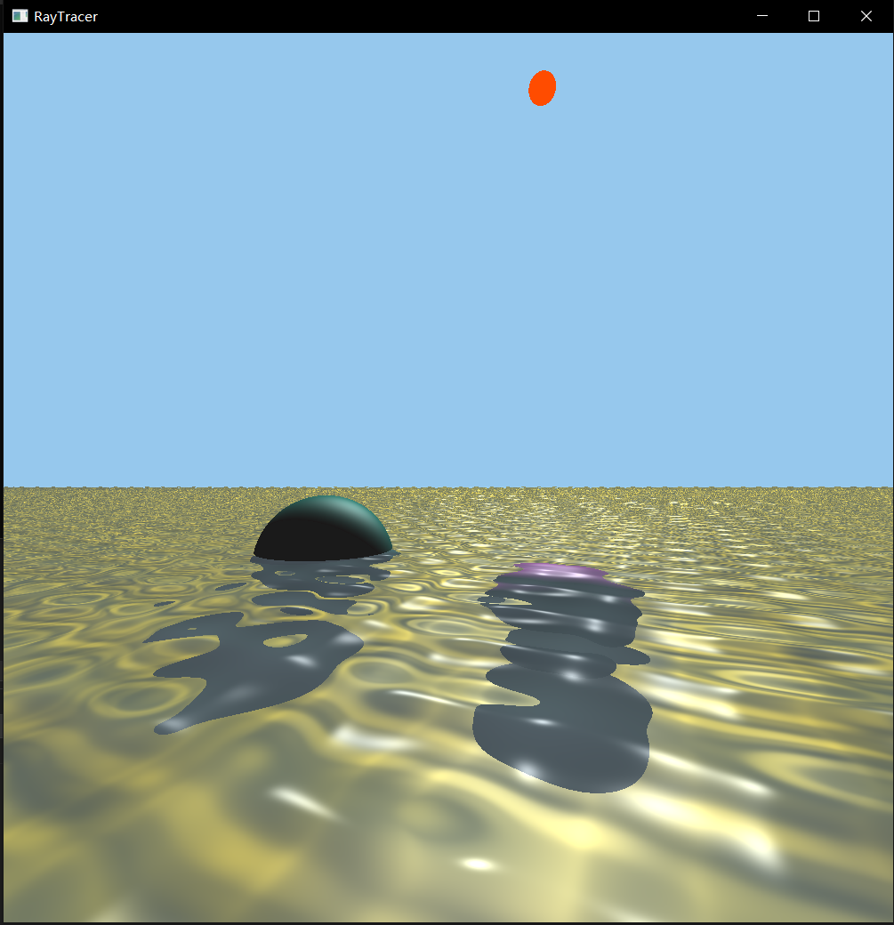
Description
We aim to simulate real-time ocean movement that mainly includes waves and caustics.
The scene is made up of 2 moving light sources, 2 spheres(one floating and one sank to the bottom), water surface and sand surface.

Slide 3
Light Sources & Sand
Light sources(Sun and Moon): They circulate around the z axis of the scene separately. Every full circle is 1 minute. To simplify the algorithm, sun and moon are represented by 2 spheres with simple unified colors on them.
Sand: Sand is generated by simple perlin noise to mimic the random color of the ocean floor.

Slide 4
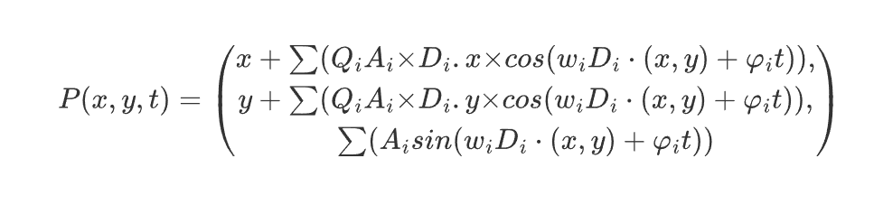
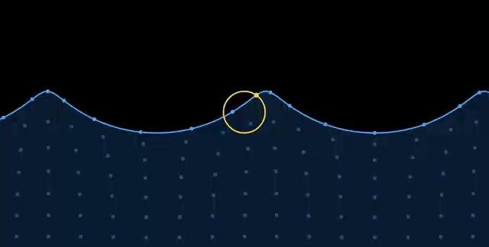
Gerstner Wave
We calculate the Partial Differentiations of the Function along x and z axis to get the “tangent” and “binormal” value of the point. After all waves are accumulated, a simple cross will get us the result normal.

Slide 5
Wave offset
Objects movement: To make the simulation realistic, we calculate the offset of the center point of the sphere and apply the offset to the sphere in real time.
It’s not as good as actual buoyancy simulation :(
Wave offset: Calculator kw for illumination difference
Kw = (Max_Steepness+offset.y)/(Max_Steepness-offset.y)

Slide 6
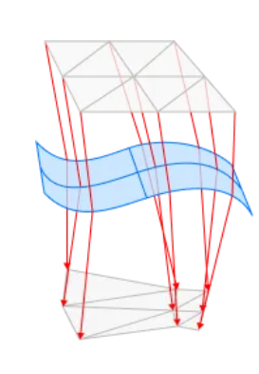
Caustics
Caustics is radiosity energy scattered by reflection & refraction.
Triangles’ area ratio determines bright/dark

Slide 7
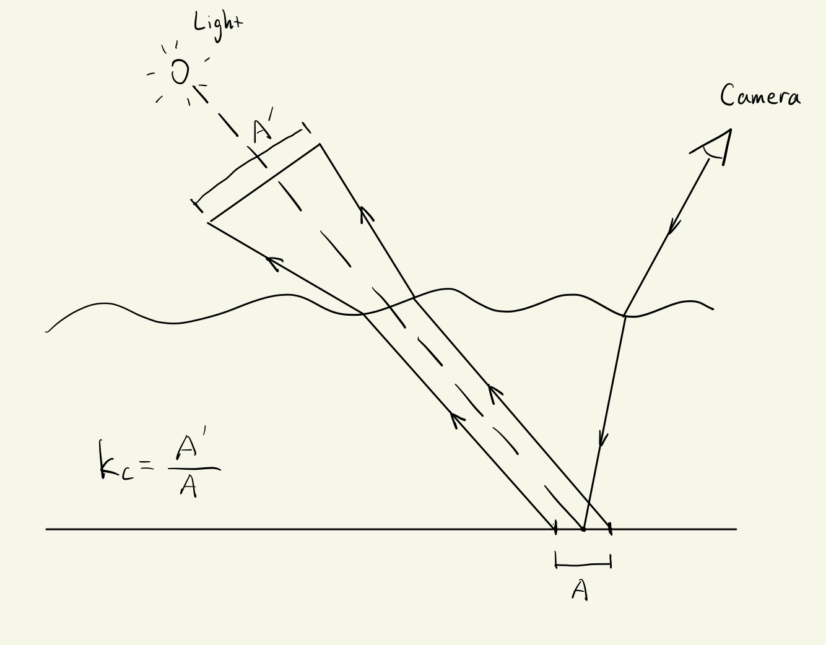
Caustics
It’s a ray tracer, reverse the process.
Apply the coefficient kc to diffuse and specular.
Parameters:
Area coefficient - definition;
Project length - contrast.

Slide 8
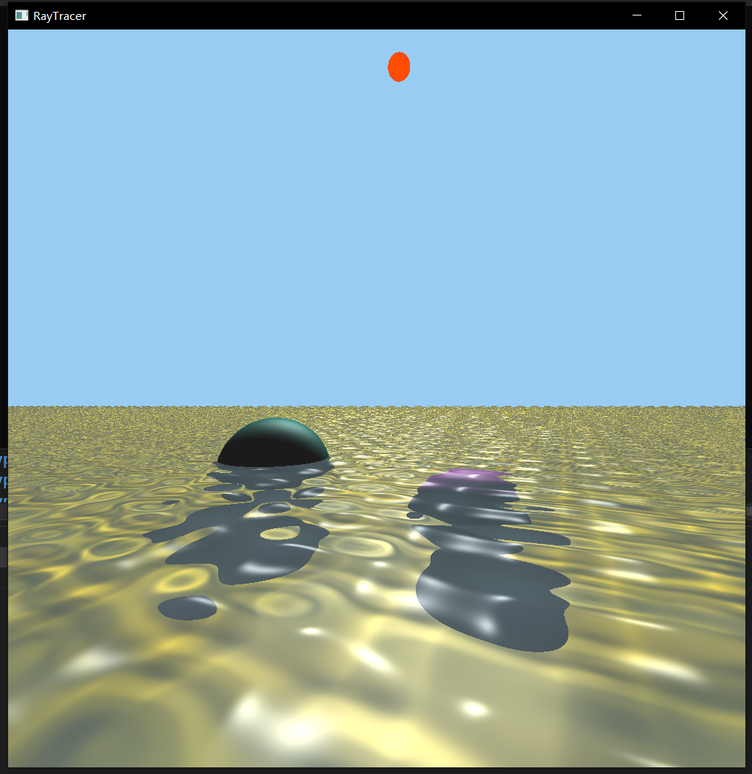
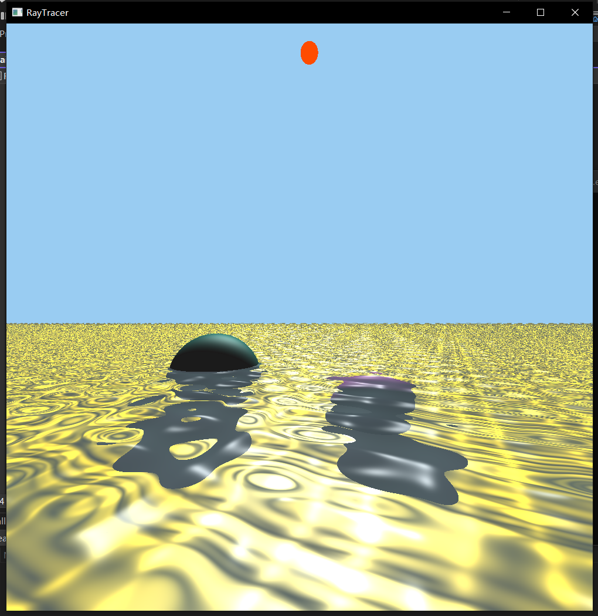
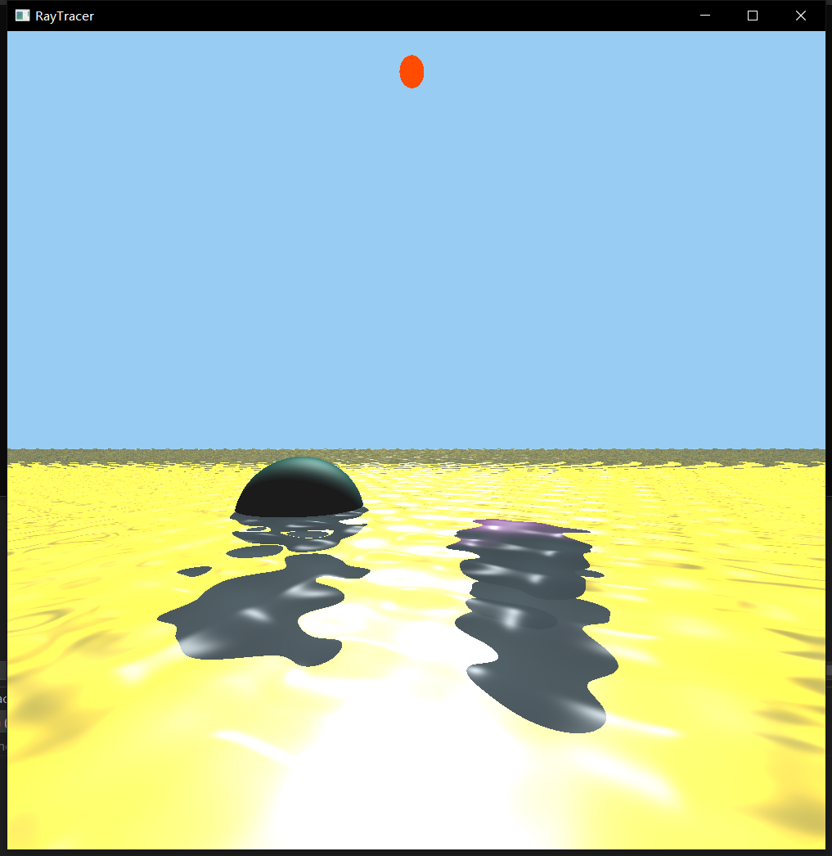
Area coefficient: 2.5
Project length: 2
Area coefficient: 2.5
Project length: 10
Area coefficient: 10
Project length: 2

Slide 9
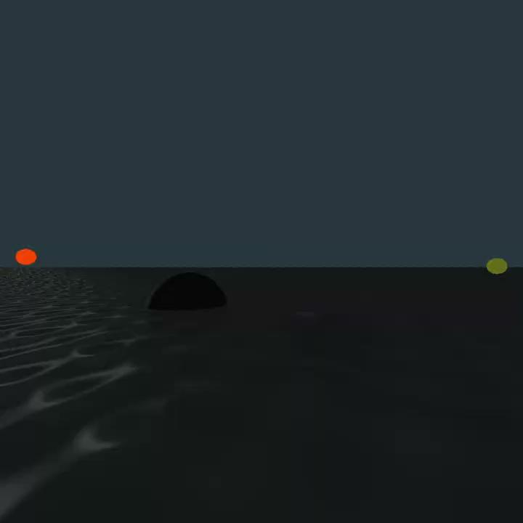
Results
15 FPS in AMD Ryzen 9 5900HS with Radeon Graphics.
Over 60 FPS in Intel 12th Gen i7-12650H.
RAM requirement: 22 GB. :(

Slide 10
Future Work
Apply simulated buoyancy to the sphere.
Add wave spray to the waves and around objects that wave is colliding with.
Have Perlin noise affects the wave.
Monte-Carlo on caustics
Optimize the RAM requirement.

